Slide 1

Project presentation for end semester evaluation
on
Design and Development of a Chess Playing Robotic arm
Presented by
Suyash Tiwari (20216041)
Shyamal Krishnan (20213077)
Md. Kaif (20213010)
Supervised by
Dr. Samir Saraswati
(Associate Professor , MED)
Department of Mechanical Engineering
Motilal Nehru National Institute of Technology Allahabad

Slide 2
Introduction
Existing robotic arms are primarily designed for repetitive industrial tasks and lack the versatility required for interactive and intelligent applications. We decided to explore a robotic system capable of autonomous decision-making and adaptability, such as a chess-playing robotic arm that can interact dynamically with its environment and make real-time decisions.
This project involves the design, simulation, and physical implementation of a 5-Degree-of-Freedom Robotic Arm. The robotic arm is modeled in Simulink and controlled via inverse kinematics to achieve desired movements. In addition to tracing specific trajectories, one of the key objectives of the project is to enable the robotic arm to play chess by moving chess pieces on a board. The arm will ultimately be controlled by servos and an Arduino setup for real-world applications.

Slide 3
Motivation
Intelligent interactive systems call for the inspiration, hence this project.
An intricate challenge for robotics is being found in chess, it’s a game that implies strategy and foresight as main constituents.
The motivation actually came from demonstrating how, to complex manipulations, which this robotic arm can realize by implementing decision-making algorithms into it.

Slide 4
Primary objectives of VIII semester
Objective: To design, implement, and evaluate a robotic arm system capable of performing accurate and efficient pick-and-place operations using servo motor control and real-time positioning, integrating mechanical, electronic, and software subsystems into a cohesive automated solution.
Key Goals:
Achieve precise positioning for pick and place tasks.
Implement reliable gripper actuation for object manipulation.
Ensure smooth motion through trajectory planning and control.
Test and validate system performance under different conditions.

Slide 5
Crude modelling
All dimensions are in mm

Slide 6
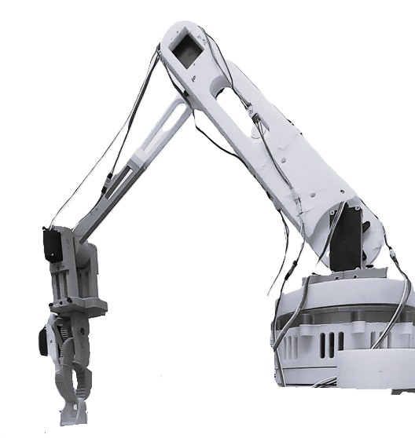
Final working model
Elbow joint.
Wrist joint
Shoulder joint
Gripper
Base

Slide 7
Pick and Place task
We mounted our robotic arm on a fixed platform and defined two positions on a chessboard-patterned sheet placed 30 cm from the turntable. The arm begins at its initial reference position, then moves to the specified pick position. The gripper closes to grasp the object, after which the arm lifts to an intermediate hold position. It then moves to the place position, releases the object by opening the gripper, and finally returns to the initial reference position.

Slide 8
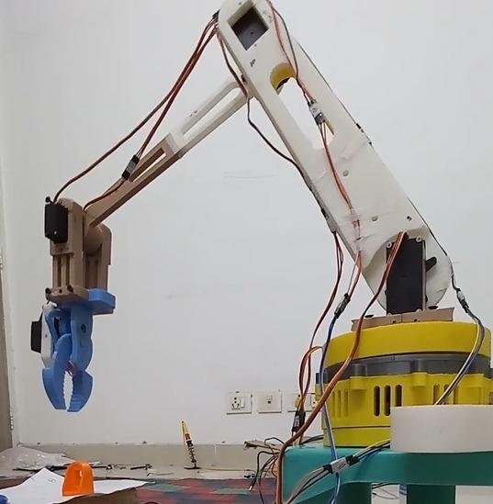
1: Reference Position
The robotic arm begins at a predefined reference or home position, ensuring consistent and repeatable operations.

Slide 9
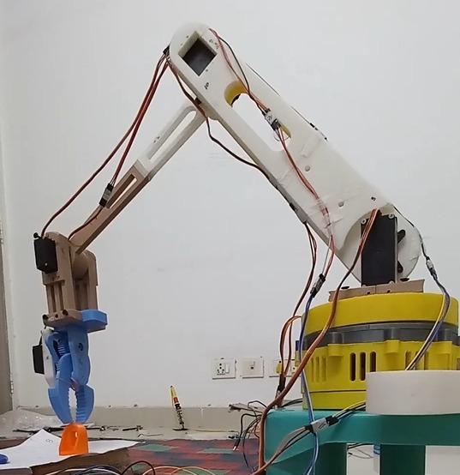
2: Move to Pick Position
The arm moves from the reference position to the location of the object it needs to pick up.

Slide 10
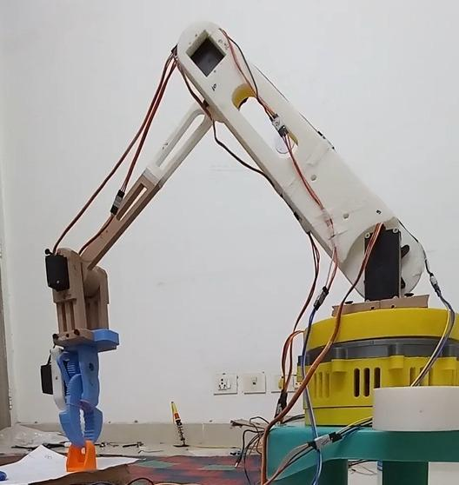
3: Gripper Close
The gripper closes securely around the object, ensuring a stable grasp.

Slide 11
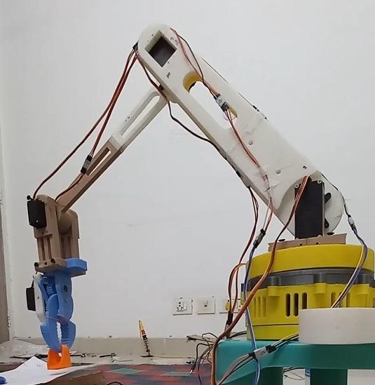
4: Return to Reference Position
With the object grasped, the arm returns to the reference position to prepare for placing.

Slide 12
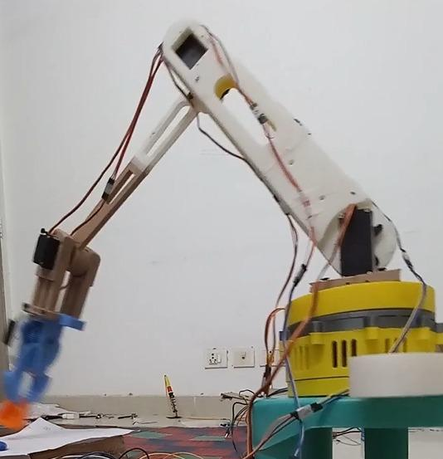
5: Move to Place Position
The arm moves to the designated place position where the object is to be deposited.

Slide 13
6: Gripper Open
The gripper opens to release the object at the desired location.

Slide 14
7: Back to Reference Position
The arm returns to the reference position, ready for the next pick-and-place cycle.

Slide 15
HARDWARE ( What we used)
Control Boards and Drivers
Arduino Uno R3 with Cable
DC to DC Converter
A4988 Stepper Motor Driver Module with Heat Sink
Mechanical Components
10mm Silver Bearing Balls: Facilitates smooth movement of the robot base, reducing friction.

Slide 16
Circuit Components
Jumper Wires (Dupont Cable)
Solderless 400-Pin Breadboard
100uF 50V Aluminum Electrolytic Capacitor
10k Ohm 0.5W Metal Film Resistor
Tactile Push Button Switch
Connectors
Arduino Connecting Cable

Slide 17
Conclusion
This project successfully developed a robotic arm capable of precise pick-and-place operations for chess pieces on a chessboard. Through careful design, component selection, and thorough testing, we created a robust and efficient system that accurately handles delicate objects. The modular design ensures future expandability and functionality.
Integrating mechanical and electronic components, along with fine-tuned controls, was key to achieving accurate and reliable movement. The arm's success in manipulating chess pieces demonstrates its precision and adaptability, highlighting its potential beyond simple material handling.

Slide 18
Conclusion
This robotic arm marks a significant step towards advanced intelligent systems. Its ability to interact with a chessboard opens doors for applications like autonomous chess play, robotic tutors, and assistive technologies. The insights gained from this project offer valuable knowledge for future robotics and automation endeavors.
Ultimately, this project not only fulfilled its goal of creating a functional chess pick-and-place robotic arm but also showcased the power of integrated system design and robotics in human-robot interaction and intelligent automation.

Slide 19
Future scope
Chess Playing feature Integration
Implement the chess-playing feature to showcase the arm’s precise control
Sensor integration with the arm.

Slide 20
Limitation
Motion Smoothing: Arm movement can be jerky, affecting precision and stability.
Gripper Issues: Difficulty gripping pieces securely, especially irregular shapes.
Limited Sensing: Reed switches offer low accuracy compared to vision systems.
No Vision Capability: Lacks the ability to recognize pieces or board states visually.

Slide 21
Reference
1. Nguyen, D. A., Luong, T. N., & Tran, V. P. N. (2016). Design
and Control Automatic Chess-Playing Robot Arm. In AETA 2015:
Recent Advances in Electrical Engineering and Related Sciences (pp.
485-496). Springer International Publishing.
2. Al-Saedi, F. A. T., & Mohammed, A. H. (2015). Design and Implementation of Chess-Playing Robotic System. IJCSET, 5(5), 90-98.
Retrieved from www.ijcset.net

Slide 22
3. Nguyen, D. A., Luong, T. N., & Tran, V. P. N. (2016). Design and Control Automatic Chess-Playing Robot Arm. In AETA 2015:Recent Advances in Electrical Engineering and Related Sciences (pp.485-496). Springer International Publishing. https://doi.org/10.1007/978-3-319-27247-4
4. P. K. Rath, N. Mahapatro, P. Nath and R. Dash, ”Autonomous Chess Playing Robot,” 2019 28th IEEE International Conference on Robot and Human Interactive Communication (RO-MAN), New Delhi, India, 2019, pp. 1-6, doi: 10.1109/RO-MAN46459.2019.8956389. keywords: Chess engine;ROS;Arduino;Computer vision;CNC control
5. Smart Builds. DIY Robot Arm Arduino Hand Gestures. Retrieved from https://smartbuilds.io/diy-robot-arm-arduino-hand-gestures/.
6. Instructables. How to Build a Chess Robot with Arduino Mega. Retrieved from https://instructables.com/How-to-Built-a-Chess-Robot-With-Arduino

Slide 23
THANK YOU

